Slide 1
Graphical User Interface CSI 211: Object Oriented Programming
Tanjina Helaly

Slide 2
Graphical Use Interface
Gives program distinctive “look” and “feel”
Provides users with basic level of familiarity
Built from GUI components (controls, widgets, etc.)
User interacts with GUI component via mouse, keyboard, etc.

Slide 3
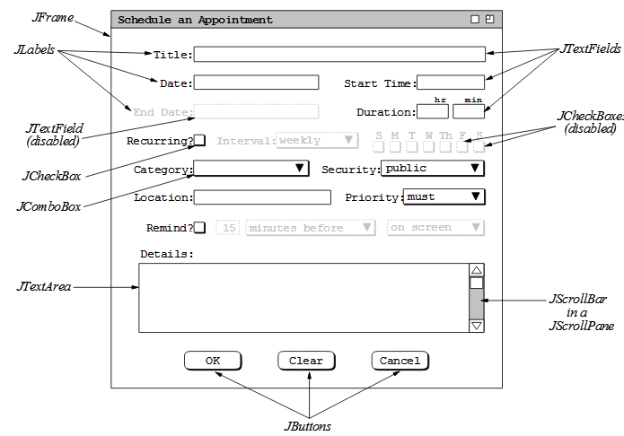
Graphical Use Interface

Slide 4
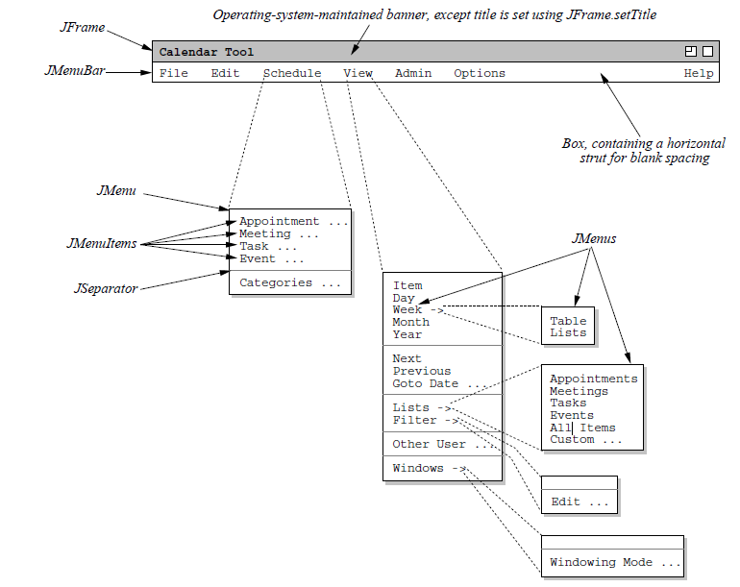
Graphical Use Interface

Slide 5
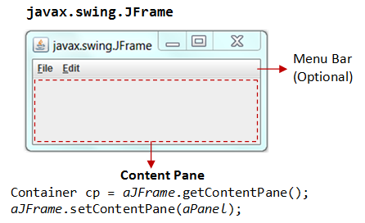
Top-Level and Secondary Containers

Slide 6
Three Parts of a GUI Application
Components that make up the Graphical User Interface
Listeners that receive the events and respond to them
Application code that does useful work for the user

Slide 7
AWT & Swing
AWT: Abstract Windowing Toolkit
Sun's initial effort to create a set of cross-platform GUI classes. (JDK 1.0 - 1.1)
Maps general Java code to each operating system's real GUI system.
Does not provide consistent, cross-platform look-and-feel
import java.awt.*
Swing: new with Java2
A newer GUI library written from the ground up that allows much more powerful graphics and GUI construction. (JDK 1.2+)
Paints GUI controls itself pixel-by-pixel rather than handing off to OS.
Benefits: light weight, new features; compatibility; same look & feel across different platform.
import javax.swing.*

Slide 8
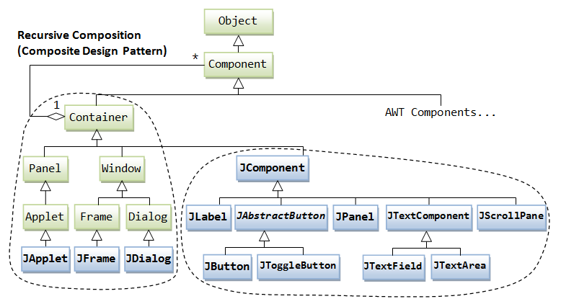
GUI Hierarchy

Slide 9
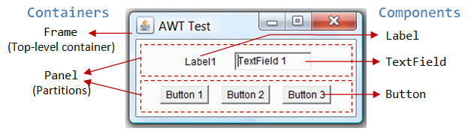
Containers
There are three basic top-level containers
JWindow: top-level window with no border
JFrame: top-level window with border and (optional) menu bar
JDialog: used for dialog windows
Another important container
JPanel: used mostly to organize objects within other containers

Slide 10
GUI Component API
Each component is a class. So, each component has
Properties/attributes
Methods
Events

Slide 11
Steps to create GUI–Basic Workflow
Create the top level container/window to hold the entire GUI.
Add components to it or other lower level container.
Add individual component. Or
Group components into a lower level container and add that container to top window.
Organize these with
A layout manager, and
JPanel to group components
Add event handling code.

Slide 12
Steps to create GUI – Adding Components
Create it
Instantiate object: b = new JButton(“Click here”);
Configure it
Properties: b.text = “Click here”; [avoided in java]
Methods: b.setText(“Click here”);
Add it
panel.add(b);
Listen to it
Events: Listeners

Slide 13
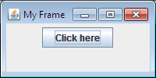
GUI Example
import javax.swing.*;
public class Hello {
public static void main(String[] args) {
JFrame f = new JFrame("My Frame"); // Creating the top level container
f.setDefaultCloseOperation(JFrame.EXIT_ON_CLOSE);
f.setSize(200, 100);
JPanel p = new JPanel();
JButton b = new JButton("Click here"); //Create a JButton object
p.add(b); // add button to panel
f.setContentPane(p); // add panel to frame
f.setVisible(true);
}
}

Slide 14
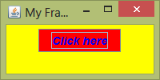
GUI Example
import javax.swing.*;
public class Hello {
public static void main(String[] args) {
JFrame f = new JFrame("My Frame"); // Creating the top level container
f.setDefaultCloseOperation(JFrame.EXIT_ON_CLOSE);
f.setSize(200, 100);
JPanel p = new JPanel();
p.setBackground(Color.cyan); // Setting the background color of the panel
JButton b = new JButton("Click here"); //Create a JButton object
b.setBackground(Color.red); //Set Button color
b.setForeground(Color.BLUE); // Setting the text color of the button
b.setFont(new Font("SansSerif", Font.BOLD + Font.ITALIC, 14));
p.add(b); // add button to panel
f.setContentPane(p); // add panel to frame
f.setVisible(true);
}
}

Slide 15
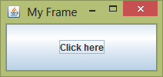
GUI Example
import javax.swing.*;
public class Hello {
public static void main(String[] args) {
JFrame f = new JFrame("My Frame"); // Creating the top level container
f.setDefaultCloseOperation(JFrame.EXIT_ON_CLOSE);
f.setSize(200, 100);
Container p = f.getContentPane();
JButton b = new JButton("Click here"); //Create a JButton object
p.add(b); // add button to panel
f.setVisible(true);
}
}

Slide 16
Steps to create GUI
Create:
Frame
Panel
Components
Listeners
Add: (bottom up)
listeners into components
components into panel
panel into frame

Slide 17
JFrame
a graphical window to hold other components
public JFrame() public JFrame(String title) Creates a frame with an optional title.
Call setVisible(true) to make a frame appear on the screen after creating it.
public void add(Component comp) Places the given component or container inside the frame.

Slide 18
JFrame
public void setDefaultCloseOperation(int op) Makes the frame perform the given action when it closes.
Common value passed: JFrame.EXIT_ON_CLOSE
If not set, the program will never exit even if the frame is closed.
public void setSize(int width, int height) Gives the frame a fixed size in pixels.
public void pack() Resizes the frame to fit the components inside it snugly.

Slide 19
Some components
ButtonGroup -- for grouping buttons, particular radio buttons.
JButton -- a standard command button; used all over the place.
JCheckBox -- a typical on/off checkbox.
JCheckBoxMenuItem -- a menu itme with a checkbox next to it.
JColorChooser -- a standard-looking color selection dialog.
JComboBox -- a pulldown that allows typing too.
JComponent -- the top-level of the Swing component hierarchy.
JDialog -- a handy pop-up dialog.
JEditorPane -- a way to view and edit text, in particular HTML.
JFileChooser -- a standard-looking file chooser.
JFrame -- the outermost container for a GUI window.
Jlabel -- a simple piece of text within a GUI.
JList -- a list of GUI components, typically with a scroll bar.
JMenu -- a pulldown or pop-up menu
JMenuBar -- a standard menubar, typically at the top of a JFrame.
JMenuItem -- an item in a JMenu.

Slide 20
Some components
JOptionPane -- a parent class for a set of standard option dialogs.
JPanel -- Typically the inner-wrapper of a JFrame, for managing GUI layout.
JPasswordField -- a way to enter passwords without echoing.
JProgressBar -- a typical-looking "throbber"
JRadioButton -- a typical-looking radio button
JScrollBar -- horizontal or vertical scrollbar, typically in a JScrollPane.
JSeparator -- spacing in a menu.
JSlider -- typical-looking slider ,typically for numeric input.
JTabbedPane -- tabbing pane for organizing things like preferences.
JTable -- a two-dimensional table, with many display options.
JTextArea -- a simple, unformatted multi-line text area.
JTextField -- a single-line text field.
JToggleButton -- an on/off button.
JToolBar-- a container for buttons that select other tools.
JToolTip -- roll-over help for tool buttons or menu items.
JTree -- a hierarchical tree display, in a Windows Explorer style.

Slide 21
Example - with Menu
import javax.swing.*;
class MenuFrame extends JFrame {
String msg = "";
JCheckBoxMenuItem debug, test;
MenuFrame(String title) {
super(title);
setSize(300, 200);
setDefaultCloseOperation(JFrame.EXIT_ON_CLOSE);
// create menu bar and add it to frame
JMenuBar mbar = new JMenuBar();
setJMenuBar(mbar);
// create the menu items add to the menubar
JMenu file = new JMenu("File");
JMenuItem item1 = new JMenuItem("New...");
JMenuItem item2 = new JMenuItem("Open...");
JMenuItem item3 = new JMenuItem("Close");
JMenuItem item5 = new JMenuItem("Quit...");
file.add(item1);
file.add(item2);
file.add(item3);
file.addSeparator();
file.add(item5);
mbar.add(file);

Slide 22
Example - with Menu
// Adding another menu item
JMenu edit = new JMenu("Edit");
JMenuItem item6 = new JMenuItem("Cut");
JMenuItem item7 = new JMenuItem("Copy");
JMenuItem item8 = new JMenuItem("Paste");
edit.add(item6);
edit.add(item7);
edit.add(item8);
edit.addSeparator();
JMenu sub = new JMenu("Special");
JMenuItem item10 = new JMenuItem("First");
JMenuItem item11 = new JMenuItem("Second");
JMenuItem item12 = new JMenuItem("Third");
sub.add(item10);
sub.add(item11);
sub.add(item12);
edit.add(sub);
// these are checkable menu items
debug = new JCheckBoxMenuItem("Debug");
edit.add(debug);
test = new JCheckBoxMenuItem("Testing");
edit.add(test);
mbar.add(edit);
setVisible(true);
}
}

Slide 23
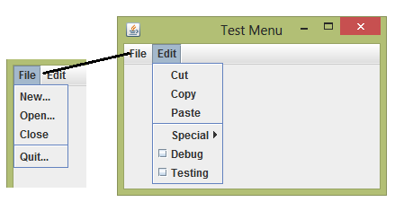
Example - with Menu
public class MenuDemo {
public static void main(String[] args){
new MenuFrame("Test Menu");
}
}

Slide 24
Example – with scrollbar
import java.awt.FlowLayout;
import javax.swing.*;
public class GUITest extends Jframe{
public GUITest(){
super();
setTitle("Create Account");
setSize(300,300);
setLayout(null);
JLabel nm = new JLabel("Name");
JTextField nmtf = new JTextField(20);
JLabel gen = new JLabel("Gender");
JCheckBox ml = new JCheckBox("Male");
JCheckBox fml = new JCheckBox("Female");
JLabel note = new JLabel("Note");
JTextArea nt = new JTextArea(5,10);
JButton submit = new JButton("Create");
JScrollPane jsp = new JScrollPane(nt, ScrollPaneConstants.VERTICAL_SCROLLBAR_ALWAYS, ScrollPaneConstants.HORIZONTAL_SCROLLBAR_AS_NEEDED);

Slide 25
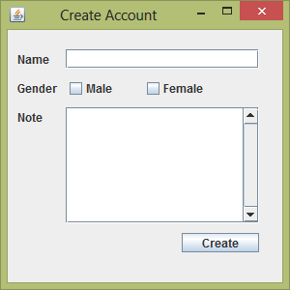
Example – with scrollbar
nm.setBounds(10, 20, 50, 20);
add(nm);
nmtf.setBounds(60, 20, 200, 20);
add(nmtf);
gen.setBounds(10, 50, 50, 20);
add(gen);
ml.setBounds(60, 50, 80, 20);
add(ml);
fml.setBounds(140, 50, 100, 20);
add(fml);
note.setBounds(10, 80, 40, 20);
add(note);
jsp.setBounds(60, 80, 200, 120);
add(jsp);
submit.setBounds(180, 210, 80, 20);
add(submit);
setVisible(true);
}
public static void main(String[] args) {
new GUITest();
}
}

Slide 26
Layout

Slide 27
What is Layout
The LayoutManagers are used to arrange components in a particular manner.
AWT provides the following layout managers (in package java.awt):
FlowLayout,
GridLayout,
BorderLayout,
GridBagLayout,
BoxLayout,
CardLayout,
and others.

Slide 28
What is Layout
Each Container object has a layout manager associated with it.
A layout manager is an instance of any class that implements the LayoutManager interface.
The layout manager is set by the setLayout( ) method.
If you do not specify a layout manager, the container will use a default:
JPanel default = FlowLayout
JFrame default = BorderLayout

Slide 29
Flow Layout
In the java.awt.FlowLayout, components are arranged
from left-to-right inside the container in the order that they are added
When one row is filled, a new row will be started.
Constructors:
FlowLayout( )
creates the default layout, which centers components and leaves five pixels of space between each component.
FlowLayout(int how)
specify how each line is aligned.
Valid values for how are as follows:
FlowLayout.LEFT
FlowLayout.CENTER
FlowLayout.RIGHT
FlowLayout.LEADING
FlowLayout.TRAILING

Slide 30
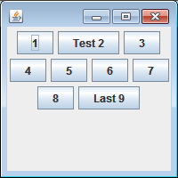
Flow Layout
public class MyLayOut{
JFrame f;
MyLayOut(){
f=new JFrame();
f.setDefaultCloseOperation(JFrame.EXIT_ON_CLOSE);
f.setLayout(new FlowLayout());
f.setSize(200,200);
JButton b1=new JButton("1");
JButton b2=new JButton("Test 2");
JButton b3=new JButton("3");
JButton b4=new JButton("4");
JButton b5=new JButton("5");
JButton b6=new JButton("6");
JButton b7=new JButton("7");
JButton b8=new JButton("8");
JButton b9=new JButton("Last 9");
f.add(b1);f.add(b2);f.add(b3);f.add(b4);f.add(b5);
f.add(b6);f.add(b7);f.add(b8);f.add(b9);
f.setVisible(true);
}
public static void main(String[] args) {
new MyLayOut();
}
}

Slide 31
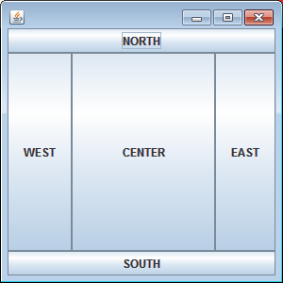
Border Layout
Default layout for a frame and divides area into named regions:
import java.awt.*;
import javax.swing.*;
public class Border {
JFrame f;
Border(){
f=new JFrame();
JButton b1=new JButton("NORTH");;
JButton b2=new JButton("SOUTH");;
JButton b3=new JButton("EAST");;
JButton b4=new JButton("WEST");;
JButton b5=new JButton("CENTER");;
f.add(b1,BorderLayout.NORTH);
f.add(b2,BorderLayout.SOUTH);
f.add(b3,BorderLayout.EAST);
f.add(b4,BorderLayout.WEST);
f.add(b5,BorderLayout.CENTER);
f.setSize(300,300);
f.setVisible(true);
}
public static void main(String[] args) {
new Border();
}
}

Slide 32
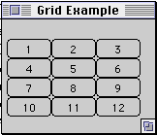
Grid Layout
In GridLayout, components are arranged in a grid (matrix) of rows and columns inside the Container.
Components are added in a left-to-right, top-to-bottom manner in the order they are added.
import java.awt.*;
class GridLayoutExample extends Frame {
public GridLayoutExample( int widthInPixels, int heightInPixels ) {
setTitle( "Grid Example" );
setSize( widthInPixels, heightInPixels );
int numberOfRows = 4;
int numberOfColumns = 3;
setLayout( new GridLayout( numberOfRows,
numberOfColumns ) );
for ( int label = 1; label < 13; label++ )
add( new Button( String.valueOf( label ) ) );
show();
}
public static void main( String args[] ) {
new GridLayoutExample( 175, 100 );
}
}

Slide 33
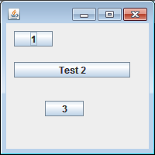
No Layout
When want to add component to a specific location.
Set the Layout to null
public class MyLayOut{
JFrame f;
MyLayOut(){
f=new JFrame();
f.setSize(200,200);
f.setLayout(null);
f.setDefaultCloseOperation(JFrame.EXIT_ON_CLOSE);
JButton b1=new JButton("1");
JButton b2=new JButton("Test 2");
JButton b3=new JButton("3");
b1.setBounds(10, 10, 50, 20);
b2.setBounds(10, 50, 150, 20);
b3.setBounds(50, 100, 50, 20);
f.add(b1);f.add(b2);f.add(b3);
f.setVisible(true);
}
public static void main(String[] args) {
new MyLayOut();
}
}

Slide 34
Layouts - Summary
FlowLayout
GridLayout
Left to right,
Top to bottom
BorderLayout
null
n
c
none, programmer sets x,y,w,h
w
e
s

Slide 35
Event Handling

Slide 36
AWT Event-Handling
Event handling is a basic concept of graphical user interfaces.
In event-driven programming,
a piece of event-handling codes is executed (or called back by the graphics subsystem)
when an event has been fired
in response to an user input
Example:
mouse clicks
keyboard entries
time intervals
Button click
This is unlike the procedural model, where codes are executed in a sequential manner.

Slide 37
Main Components
Three objects are involved in the event-handling:
a source –
GUI component with which user interact.
generates an event and sends it to one or more listeners.
listener(s) -
simply waits until it receives an event.
Receives event object when notified, then responds(processes the event and then returns)
an event object. –
Encapsulates information about event that occurred
Describe the state change of a source

Slide 38
Programmer’s responsibility
Programmer must perform two tasks
Register event listener for event source
Implement event-handling method (event handler)

Slide 39
Events
In the delegation model, an event is an object that describes a state change in a source.
an event can be generated as a consequence of a person interacting with the elements in a graphical user interface
Example:
pressing a button,
entering a character via the keyboard,
selecting an item in a list, and
clicking the mouse.
Events may also occur that are not directly caused by interactions with a user interface. For example, an event may be generated when
a timer expires,
a counter exceeds a value,
a software or hardware failure occurs,
or an operation is completed.

Slide 40
Event Source
A source is an object that generates an event.
This occurs when the internal state of that object changes in some way.
Sources may generate more than one type of event.
A source must register listeners in order for the listeners to receive notifications about a specific type of event.
Each type of event has its own registration method.
Here is the general form:
public void addTypeListener (TypeListener el )

Slide 41
Event Listeners
A listener is an object that is notified when an event occurs. It has two major requirements.
First, it must have been registered with one or more sources to receive notifications about specific types of events.
For a program to respond to an event there must be an event listener object in the GUI program that listens to that type of event
Second, it must implement methods to receive and process these notifications.
When an event is generated by the GUI component this method in the listener object is invoked to respond to the event
The methods that receive and process events are defined in a set of interfaces.

Slide 42
What If …?
When there is no event listener for an event
A program can ignore events
If there is no listener for an event, the event is just ignored

Slide 43
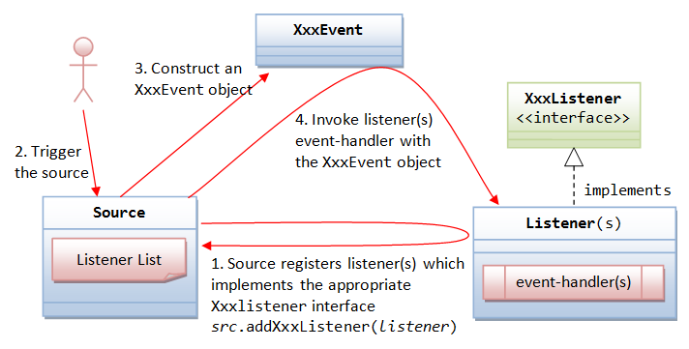
The sequence of steps in Event Handling

Slide 44
Implement Listener in Inner Class
import java.awt.*;
import java.awt.event.*;
import javax.swing.*;
public class Counter{
JFrame f;
JTextField tf;
public Counter(){
f = new JFrame("Counter");
f.setLayout(new FlowLayout());
f.setSize(200, 100);
f.setDefaultCloseOperation(JFrame.EXIT_ON_CLOSE);
f.add(new JLabel("Counter"));
tf = new JTextField(10);
f.add(tf);
tf.setText("0");
JButton b = new JButton("Count");
f.add(b);
b.addActionListener(new CounterAction());
f.setVisible(true);
}
public static void main(String[] args) {
new Counter();
}
public class CounterAction implements ActionListener {
public void actionPerformed(ActionEvent e) {
tf.setText(Integer.parseInt(tf.getText()) + 1 +"");
}
}}
Register the listener to the source
Implement the Listener Inner Class

Slide 45
Implement Listener in Own Class
import java.awt.*;
import java.awt.event.*;
import javax.swing.*;
public class Counter implements ActionListener{
JFrame f;
JTextField tf;
public Counter(){
f = new JFrame("Counter");
f.setLayout(new FlowLayout());
f.setSize(200, 100);
f.setDefaultCloseOperation(JFrame.EXIT_ON_CLOSE);
f.add(new JLabel("Counter"));
tf = new JTextField(10);
f.add(tf);
tf.setText("0");
JButton b = new JButton("Count");
f.add(b);
b.addActionListener(this);
f.setVisible(true);
}
public void actionPerformed(ActionEvent e) {
tf.setText(Integer.parseInt(tf.getText()) + 1 +"");
}
public static void main(String[] args) {
new Counter();
}
}
Implement the listener
Register the listener to the source
Implement the method to handle the event

Slide 46
Implement Listener in Anonymous Class
import java.awt.*;
import java.awt.event.*;
import javax.swing.*;
public class Counter{
JFrame f;
JTextField tf;
public Counter(){
f = new JFrame("Counter");
f.setLayout(new FlowLayout());
f.setSize(200, 100);
f.setDefaultCloseOperation(JFrame.EXIT_ON_CLOSE);
f.add(new JLabel("Counter"));
tf = new JTextField(10);
tf.setText("0");
JButton b = new JButton("Count");
f.add(tf); f.add(b);
b.addActionListener(new ActionListener(){
public void actionPerformed(ActionEvent e) {
tf.setText(Integer.parseInt(tf.getText()) + 1 +"");
}
});
f.setVisible(true);
}
public static void main(String[] args) {
new Counter();
}
}
Register the anonymous listener object to the source

Slide 47
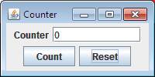
Multiple buttons
import java.awt.*;
import java.awt.event.*;
import javax.swing.*;
public class Counter extends JFrame implements ActionListener{
JTextField tf;
JButton b, r;
public Counter(){
super("Counter"); setSize(200, 100);
setLayout(new FlowLayout());
setDefaultCloseOperation(JFrame.EXIT_ON_CLOSE);
add(new JLabel("Counter"));
tf = new JTextField("0“, 10);
b = new JButton("Count");
r = new JButton("Reset");
add(tf);add(b);add(r);
setVisible(true);
b.addActionListener(this);
r.addActionListener(this);
}
public void actionPerformed(ActionEvent e) {
Object obj = e.getSource();
if (obj == b)
tf.setText(Integer.parseInt(tf.getText()) + 1 +"");
else if(obj == r)
tf.setText("0");
}
public static void main(String[] args) { new Counter();}
}
Identify the source first and then implement the logic depending on the source

Slide 48
List of Some common Source, Event and Listener
Source | Event | Interface | Methods
Button (Click) List (Double clicked) MenuItem (Clicked) Timer | ActionEvent | ActionListener | void actionPerformed(ActionEvent ae)
CheckBox | ItemEvent | ItemListener | void itemStateChanged(ItemEvent ie)
Frame(via Keyboard) | KeyEvent | KeyListener | void keyPressed(KeyEvent ke) void keyReleased(KeyEvent ke) void keyTyped(KeyEvent ke)
Frame(Mouse action) | MouseEvent | MouseListener | void mouseClicked(MouseEvent me) void mouseEntered(MouseEvent me) void mouseExited(MouseEvent me) void mousePressed(MouseEvent me) void mouseReleased(MouseEvent me)
Frame(Mouse Move) | MouseEvent | MouseMotionListener | void mouseDragged(MouseEvent me) void mouseMoved(MouseEvent me)
TextField/TextArea(changing text) | TextEvent | TextListener | void textValueChanged(TextEvent te)
Window/Frame | WindowEvent | WindowListener | void windowActivated(WindowEvent we) void windowClosed(WindowEvent we) void windowClosing(WindowEvent we) void windowDeactivated(WindowEvent we) void windowDeiconified(WindowEvent we) void windowIconified(WindowEvent we) void windowOpened(WindowEvent we)

Slide 49
Adapter Classes
Suppose your class directly implements MouseListener
Then you must implement all five MouseListener methods.
Even if you care only about mouse clicks
Methods for those events you don't care about can have empty bodies.
Resulting collection of empty method bodies can make code harder to read and maintain
How to avoid?
Use adapter classes
An adapter class implements empty versions of all its interface's methods.
For example, the MouseAdapter class implements the MouseListener interface.

Slide 50
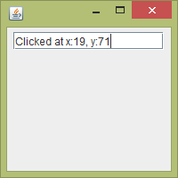
GUI Example – Mouse event with adapter
import java.awt.FlowLayout;
import java.awt.event.MouseAdapter;
import java.awt.event.MouseEvent;
import javax.swing.JFrame;
import javax.swing.JTextField;
public class TestMouseEvent {
public static void main(String[] args) {
JFrame f = new JFrame();
f.setLayout(new FlowLayout());
f.setSize(200, 200);
f.setDefaultCloseOperation(JFrame.EXIT_ON_CLOSE);
JTextField tf = new JTextField(15);
f.add(tf);
f.addMouseListener(new MouseAdapter() {
@Override
public void mouseClicked(MouseEvent e) {
tf.setText("Clicked at x:"+e.getX()+", y:"+e.getY());
}
});
f.setVisible(true);
}
}

Slide 51
GUI Example – Mouse event with listener & Annonymous Class
import java.awt.FlowLayout;
import java.awt.event.*;
import javax.swing.JFrame;
import javax.swing.JTextField;
public class TestMouseListener{
public static void main(String[] args) {
JFrame f = new JFrame();
f.setLayout(new FlowLayout());
f.setSize(200, 200);
f.setDefaultCloseOperation(JFrame.EXIT_ON_CLOSE);
JTextField tf = new JTextField(15);
f.add(tf);
f.addMouseListener(new MouseListener() {
public void mouseReleased(MouseEvent e) {}
public void mousePressed(MouseEvent e) {}
public void mouseExited(MouseEvent e) {}
public void mouseEntered(MouseEvent e) {}
public void mouseClicked(MouseEvent e) {
tf.setText("Clicked at x:"+e.getX()+", y:"+e.getY());
}
});
f.setVisible(true);
}
}

Slide 52
GUI Example – Mouse event with listener
import java.awt.FlowLayout;
import; java.awt.event.*;
import javax.swing.JFrame;
import javax.swing.JTextField;
public class TestMouseListener implements MouseListener{
JTextField tf ;
public TestMouseListener() {
JFrame f = new JFrame();
f.setLayout(new FlowLayout());
f.setSize(200, 200);
f.setDefaultCloseOperation(JFrame.EXIT_ON_CLOSE);
tf = new JTextField(15);
f.add(tf);
f.addMouseListener(this);
f.setVisible(true);
}
public static void main(String[] args) {
new TestMouseListener();
}
public void mouseClicked(MouseEvent e) {
tf.setText("Clicked at x:"+e.getX()+", y:"+e.getY());
}
public void mousePressed(MouseEvent e) { }
public void mouseReleased(MouseEvent e) { }
public void mouseEntered(MouseEvent e) { }
public void mouseExited(MouseEvent e) { }
}

Slide 53
Reference
Java: Complete Reference - Chapter 24-26, 31-33
Java: How to Program – Chapter 12

